Slide 1
Density Mapping of Dating App Users across Time and Space in Mumbai, India
Benjamin Eveslage, Purvi Shah, Caleb Parker, Bitra George, Jiban Baishya
24 July 2018
TUPDE0103

Slide 2
Purpose
LINKAGES developed a new way for HIV programs to visualize the density and estimate the number of location-based dating app users (Grindr) to help:
Guide outreach workers on where and when to set their phones’ GPS location to find high number of dating app users
Target ads on dating apps to high density pockets that are nearby existing HIV testing campaigns and events
Estimate the number of active users across cities in India at certain days/times

Slide 3
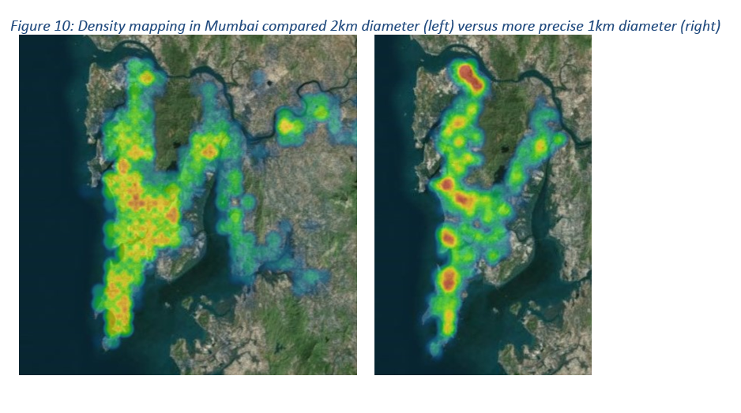
Density Mapping in Mumbai - Improved Methodology
LINKAGES has improved the precision of density mapping approaches to allow HIV programs to more easily identify clusters of dating app users
November 2017
December 2017
Notes:
The HIV program in India has been strong for many years working on prevention and treatment services for all key populations. In the last couple of years it was observed that there was a gap seen in the prevalence reported in studies like IBBS as compared to the prevalence that was reported from the Targeted Interventions (NGO/CBO). A large number of key populations reported to have moved out of physical spaces for finding clients/partners and were now using mobile phones to contact them. Social media and dating apps have become the way forward for key populations ensuring anonymity and privacy. LINKAGES India, through Grindr, a gay dating app, conducted a density mapping exercise to understand the location of the users in order to target program efforts in those areas. The slide shows snapshots of density mapping conducted in Mumbai. The picture on the left shows the density of users plotted on points 1km away from each other while the picture on the right shows density mapped on points 500m away from each other. The latter was a result of improved methodology over time as it was observed that with smaller distances between the points the data collector was able to view all the profiles in a highly populated area (i.e. because Grindr limits the number of viewable nearby profiles). In a city like Mumbai which is surrounded by water, many points were showing lower density as they were partly covering water bodies, but reducing the sampling radius helped reduce that bias. The difference can be seen by comparing the two snapshots.

Slide 4

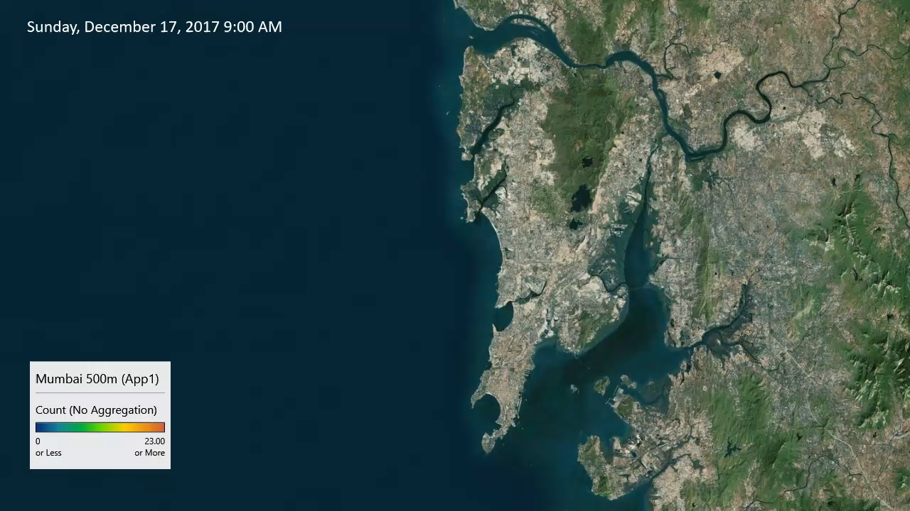
Density Mapping
Mumbai | Sampling 409 500 m-separated points across metro-Mumbai 3x per day, 7 days of a week
Notes:
The density mapping in Mumbai was done 3 times a day over 7 days of the week to understand the changes in density with regards to location and time. The top left corner denotes the time and day for your reference. It was observed that during the weekends the north of Mumbai which is the suburbs ( where people reside) are denser and during the weekdays the density increases down south which are known to be work places.
Some notes on this exercise:
We consulted with MSM communities and networks in India prior to implementing the data collection and ensured at every stage that collected data could not be used against dating app users or the MSM community at large. In fact, no individual data was ever collected through this process and the presentation of data is not granular enough to target MSM in physical settings (1km size areas).
This process collects data on number of online users within a certain radius of equidistant points, therefore there are areas between the sampled points that are not captured (the diamonds between the circles).
The process uses the dating apps like the average user would. So the data collector will view the nearby profiles, just as any other user also sees users nearby them. Therefore it does not take into account any algorithms on the back-end of the apps that might affect the number of users that the data collector can view (because this can vary by user account).

Slide 5


Stay Connected with LINKAGES
Follow LINKAGES on Twitter:
www.twitter.com/LINKAGESproject
Like the project on Facebook:
www.facebook.com/LINKAGESproject
Subscribe to the LINKAGES blog
www.linkagesproject.wordpress.com
Subscribe to The LINK, LINKAGES’s quarterly
project e-newsletter

Slide 6






Acknowledgments

